Slide 1
Amplify Planning & Forecasting with Gen AI
July 2024

Slide 2






Use Case
Challenges
Solution
Highly manual and time-consuming process
Non- reliable external data sources
GenAI-driven insights to support financial/logistic planning & Forecasting
Lack of Transparency
Discrete standards for determining predicted values
Extract most accurate and relevant external market economic condition, customer trends, world affairs in form of planning factors
No supplementary documents to verify
Requires specific skills
Provide structured inputs to determine upcoming trends and risks which can influence the forecasts with supplementary documentation
Realtime interface with planning and forecasting engines with capability to propose action or automatically apply mark-ups/mark-downs
Value Proposition
Defined planning engine learning models based on past prediction vs actual data for continuous improvement in prediction accuracy.
Automatic and optimized forecasting factor inputs
High accuracy of predicted values
Multi-lingual notification to approvers, requestors and data stewards
Reliable and standardized data sources
Early determination of risks
Uniformed criteria to determine forecasting factors
Transparency in criteria of determining adjustments
Summarization
Propose action
Open query
Automatic execution
Translation

Slide 3

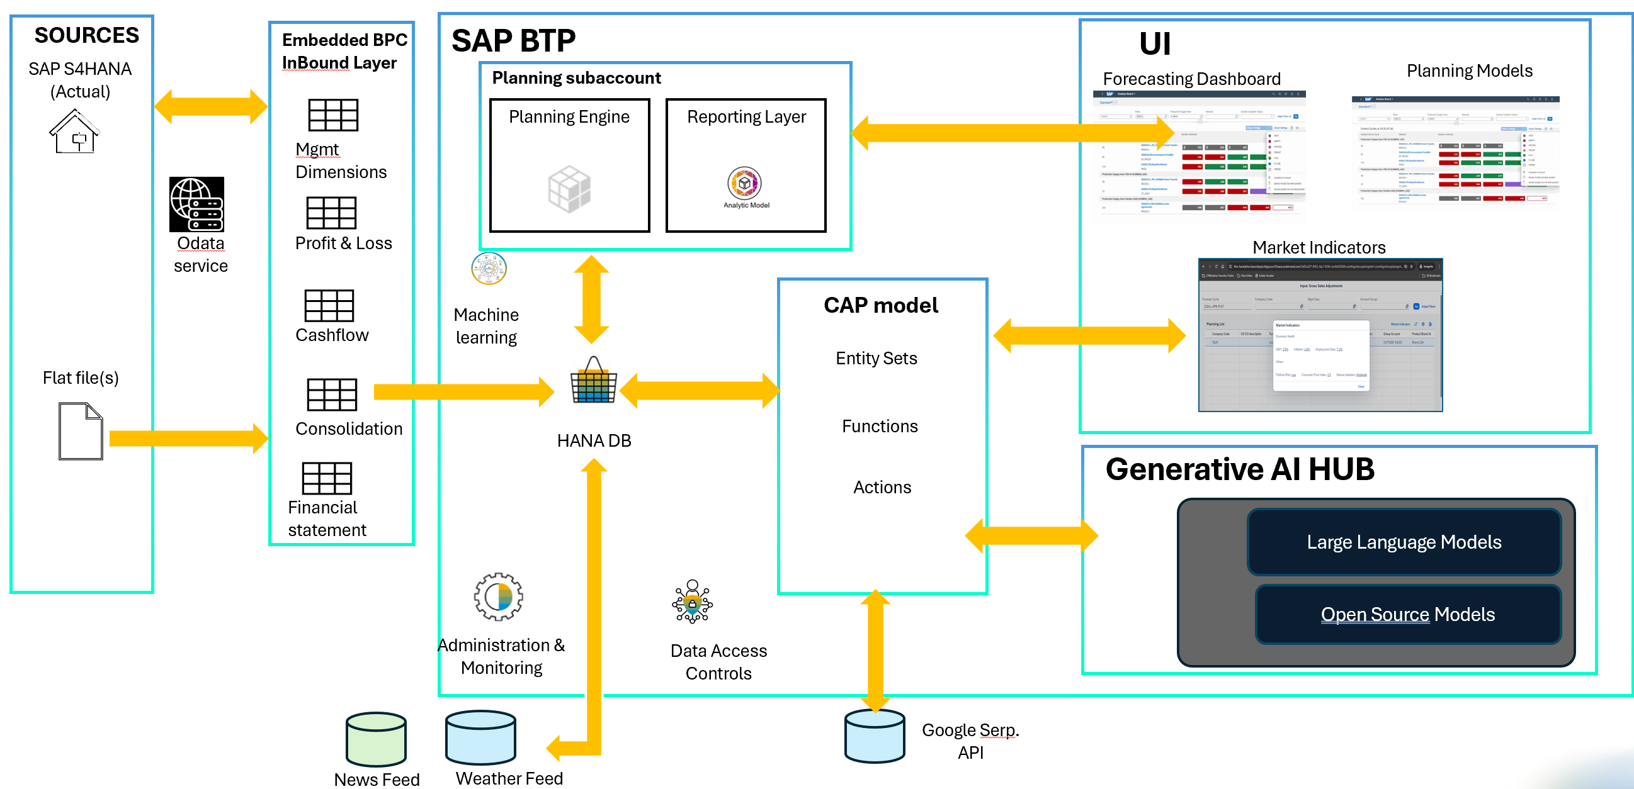
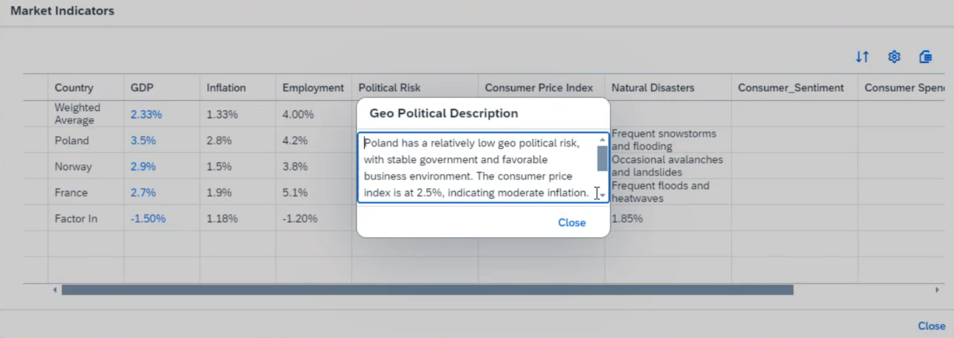
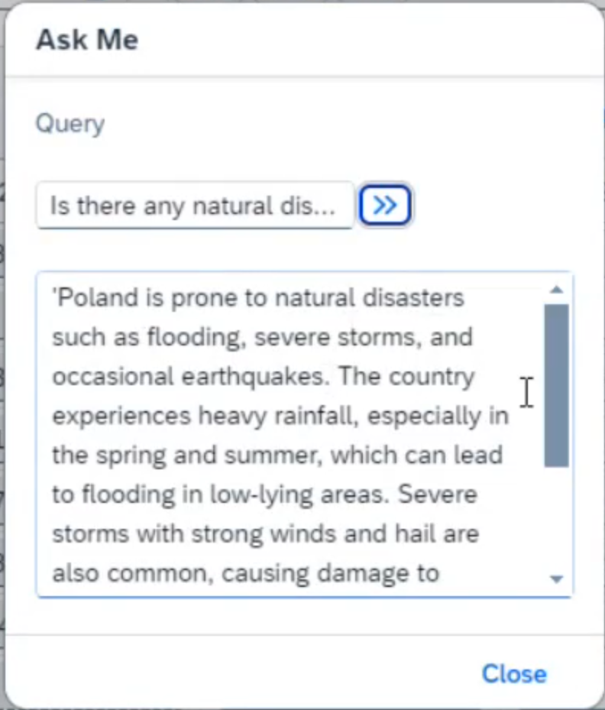
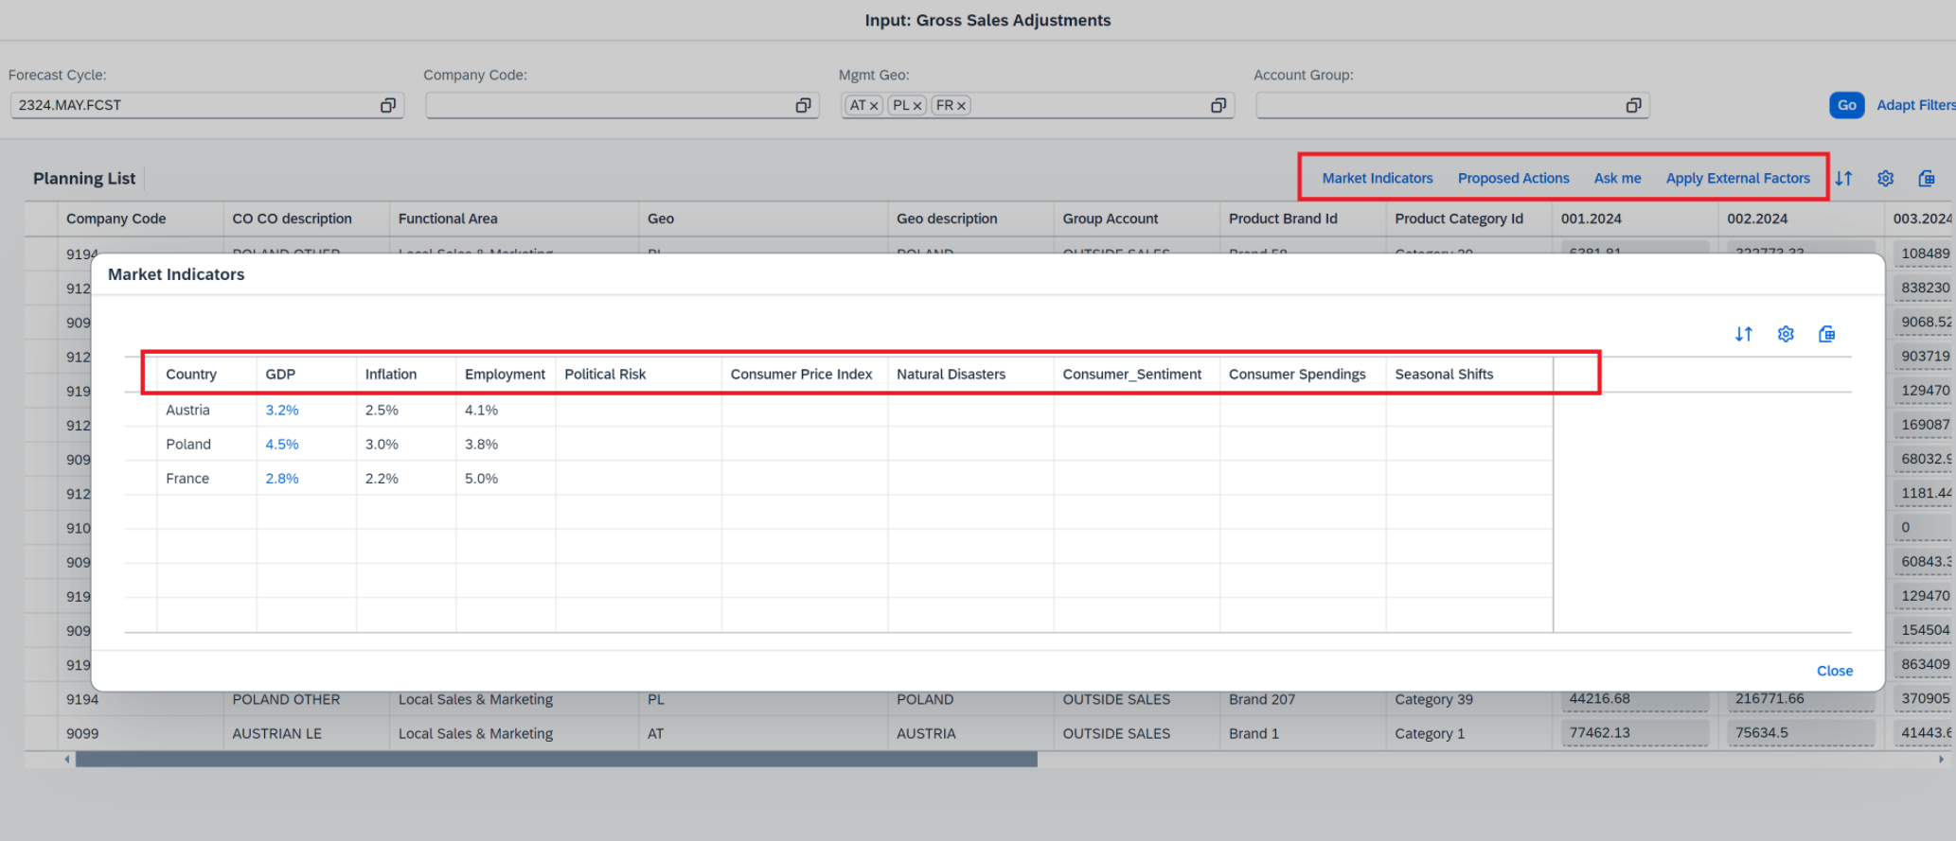
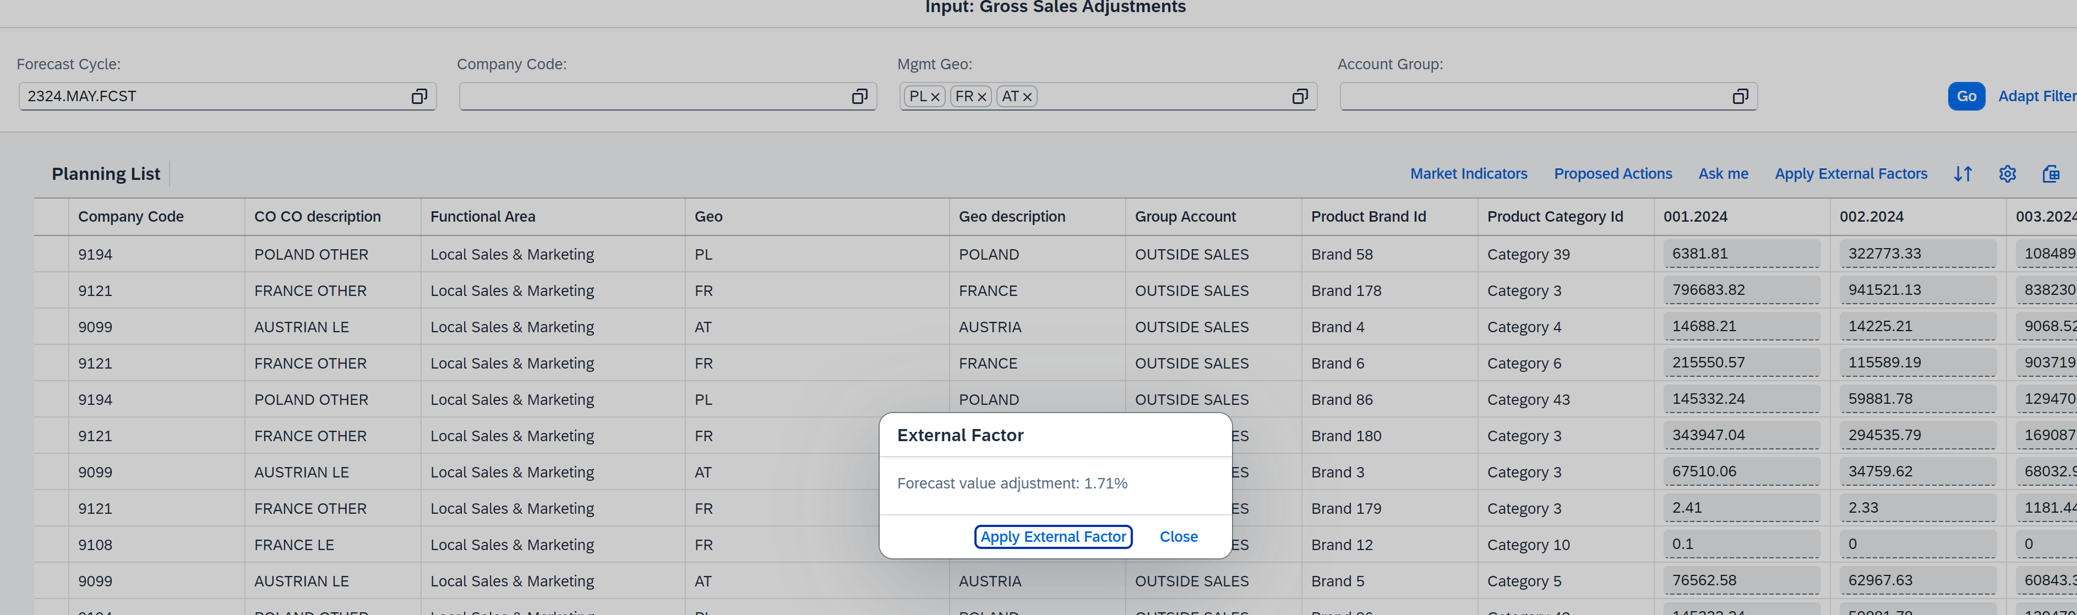
Solution overview

